Slide 1
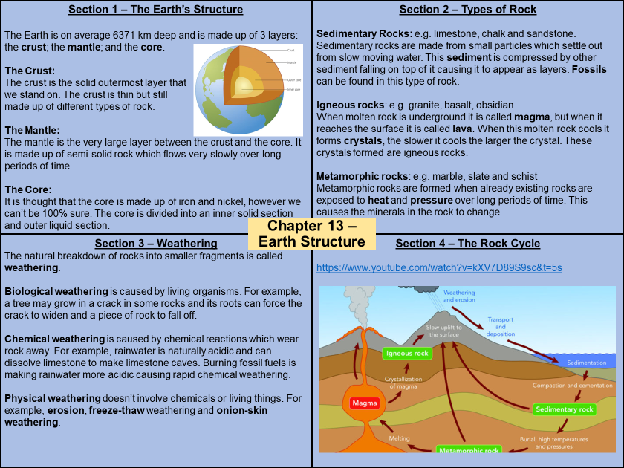
How do I use a Knowledge Organisers? Guidance for Parents/Carers
For each mini outcome within the project a knowledge organiser (KO) has been produced outlining the key knowledge required to fully understand the learning for that 3 – 4 week period.
• Children will be set the KO to learn for homework.
• A mini quiz will then be given to assess how well the students have memorised, and understood, the section of knowledge set.

Slide 2
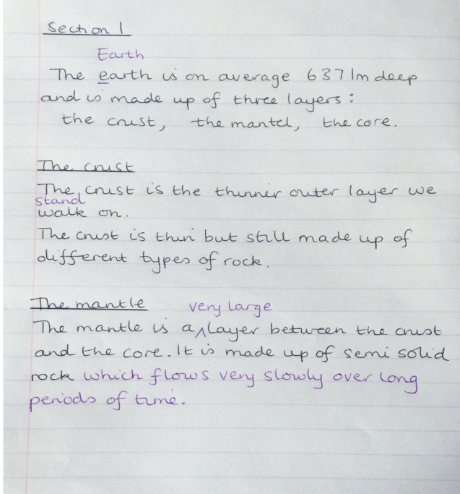
Children should…
LOOK – Read the specific part they need to learn for homework.
SAY – Read out loud the specific part they.
COVER – Cover the KO.
WRITE – Write out everything you can remember from the specific part of the KO in your workbook.
CHECK – Check that you have all the content needed and it is correct. Any content that is missing or incorrect use a purple pen to illustrate the gaps in your knowledge that you have corrected.
x3 – Repeat 3 times.
LOOK SAY COVER WRITE CHECK

Slide 3
Look, say, cover,
write & check.
Simple, good to use with spellings, defining keywords and remembering facts.
Look at the KO and read the knowledge
Say the knowledge
Cover up the knowledge
Write down what is remembered in 1 colour
(black in example)
Check to see if it is correct, make any improvements in a
different colour (purple in
example like we do in school)

Slide 4
There are also other activities which may accompany your knowledge organiser:
Recording research using the websites provided on the knowledge organiser
Art work to help children remember key facts or dates
Poster with key information
Idea for a story created with given language
These will also help the knowledge to move to your long term memory so that you will be able to use it throughout your life.

Slide 5
Low Stakes Quiz.
To ensure the knowledge learnt moves to the long term memory we use fun low stakes quizzes to practice retrieving the information. These can be:
Multiple choice answers – paper based or Ipad
Early morning work to complete first thing in the morning
Questions linked to a game on the computer or Ipad
Team or whole class games.

